Slide 1
Real Estate Management System – DevOps & Microservices Architecture
Modern software solutions for efficient property management
Notes:
AI-generated content may be incorrect. ---

Slide 2
Introduction & Project Overview
Notes:
--- This slide references information from the following file: https://apiitlk-my.sharepoint.com/personal/ama_apiit_lk/Documents/Microsoft%20Copilot%20Chat%20Files/AWS_Istio_Microservice_Architecture.md,https://apiitlk-my.sharepoint.com/personal/ama_apiit_lk/Documents/Microsoft%20Copilot%20Chat%20Files/Microservices%20List.md Project Description and Objectives

Slide 3

Project Description and Objectives
Scalable Microservices Platform
The project builds a distributed microservices platform to manage properties, leases, and tenants efficiently.
Security and Compliance
Implements zero trust security principles ensuring data protection and compliance auditing in the system.
Automation and CI/CD Integration
Seamless integration of CI/CD pipelines and GitOps for automated deployments and continuous delivery.
Observability and Resilience
Focus on monitoring, alerting, and orchestration with Kubernetes to ensure performance and reliability.
Notes:
--- This slide references information from the following file: https://apiitlk-my.sharepoint.com/personal/ama_apiit_lk/Documents/Microsoft%20Copilot%20Chat%20Files/AWS_Istio_Microservice_Architecture.md,https://apiitlk-my.sharepoint.com/personal/ama_apiit_lk/Documents/Microsoft%20Copilot%20Chat%20Files/Microservices%20List.md The Real Estate Management System project aims to create a distributed, microservices-based platform for managing properties, leases, tenants, and notifications. The primary objective is to deliver a scalable, secure, and automated solution that supports property registration, lease management, and compliance auditing. This system addresses the growing need for digital transformation in real estate operations by leveraging modern cloud-native technologies. The anticipated outcomes include improved operational efficiency, enhanced security through zero trust principles, and seamless integration of CI/CD pipelines for continuous delivery. The project also emphasizes observability, monitoring, and proactive alerting to ensure reliability and performance. By adopting Kubernetes for container orchestration and GitOps for deployment automation, the solution ensures agility and resilience in managing infrastructure and application lifecycles.

Slide 4
System Architecture
Notes:
--- This slide references information from the following file: https://apiitlk-my.sharepoint.com/personal/ama_apiit_lk/Documents/Microsoft%20Copilot%20Chat%20Files/AWS_Istio_Microservice_Architecture.md High-Level Architecture with AWS and Istio

Slide 5
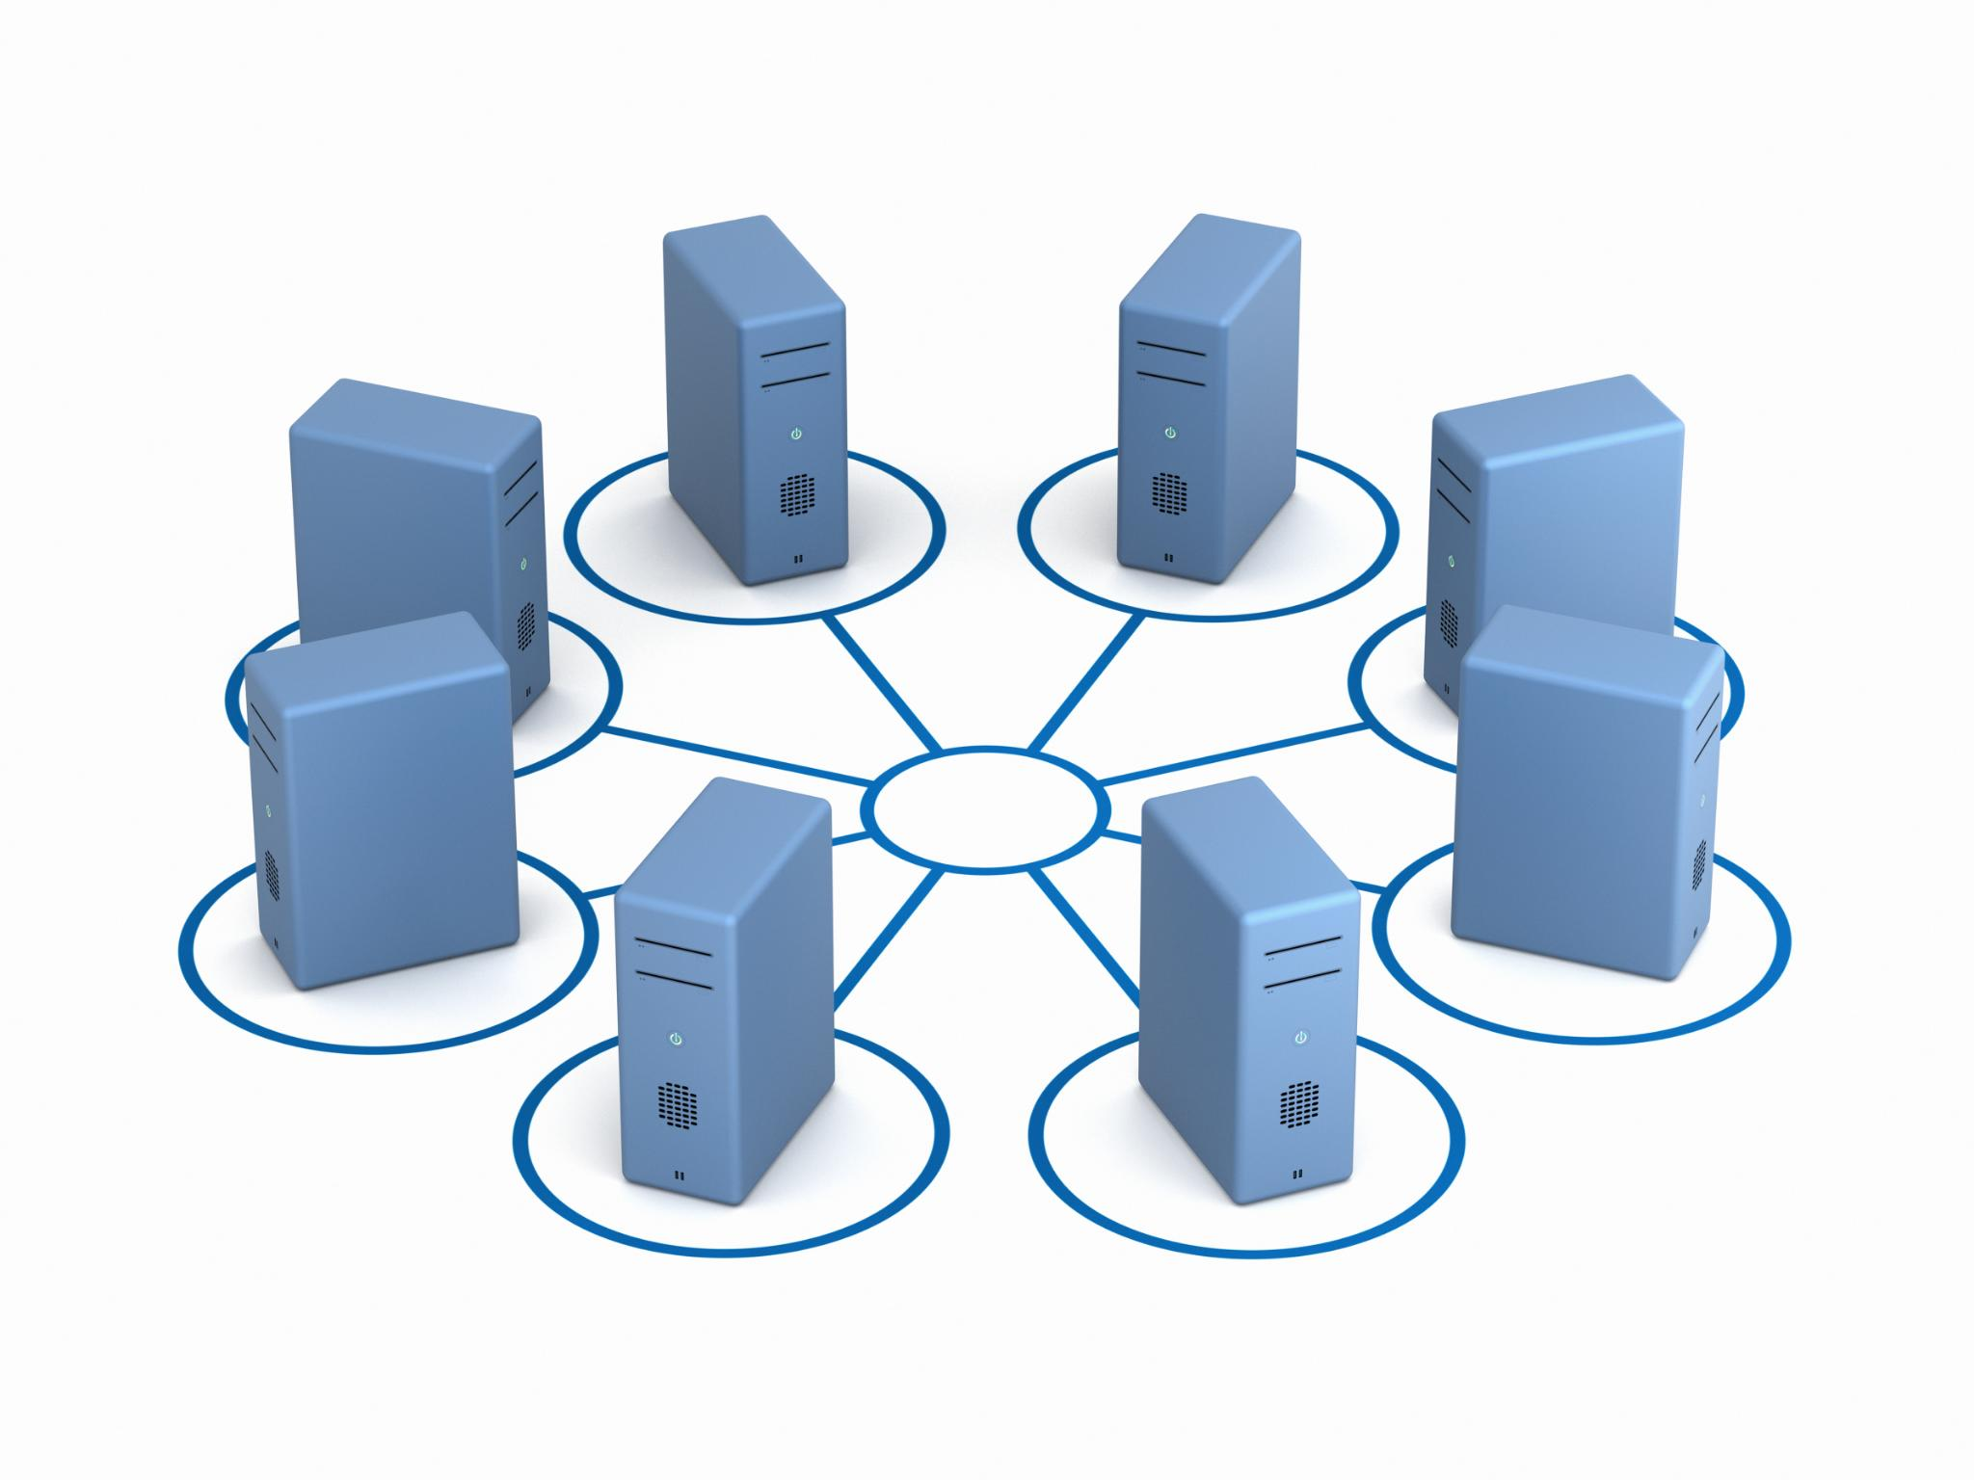
High-Level Architecture with AWS and Istio
Kubernetes Cluster on AWS
AWS VPC hosts an EC2-based Kubernetes cluster with control plane and worker nodes running microservices.
Istio Service Mesh
Istio sidecar proxies provide service mesh features like mTLS, traffic routing, telemetry, and zero trust security enforcement.
Database Layer
MySQL server hosts multiple schemas for users, properties, leases, audit logs, and notifications ensuring structured data storage.
Observability and CI/CD
Prometheus, Grafana, Fluentd, OpenSearch enable monitoring and logging; GitHub Actions, Trivy, and ArgoCD power CI/CD workflows.
Notes:
--- This slide references information from the following file: https://apiitlk-my.sharepoint.com/personal/ama_apiit_lk/Documents/Microsoft%20Copilot%20Chat%20Files/AWS_Istio_Microservice_Architecture.md The architecture is built on AWS Cloud, utilizing a VPC network hosting an EC2-based Kubernetes cluster. The cluster comprises control plane nodes and multiple worker nodes running microservices. Each microservice pod is injected with an Istio sidecar proxy to enable service mesh capabilities, including mTLS for secure communication and zero trust enforcement. The Istio control plane manages traffic routing, telemetry, and security policies. The database layer consists of a MySQL server hosting multiple schemas for users, properties, leases, audit logs, and notifications. Observability is achieved through Prometheus for metrics, Grafana for dashboards, Fluentd for log collection, and OpenSearch for log analytics. CI/CD workflows are powered by GitHub Actions, integrated with Trivy for image scanning and ArgoCD for GitOps-based deployments. This architecture ensures modularity, scalability, and security across all components.

Slide 6
Microservices Overview
Notes:
--- This slide references information from the following file: https://apiitlk-my.sharepoint.com/personal/ama_apiit_lk/Documents/Microsoft%20Copilot%20Chat%20Files/Microservices%20List.md Core Services and Responsibilities

Slide 7
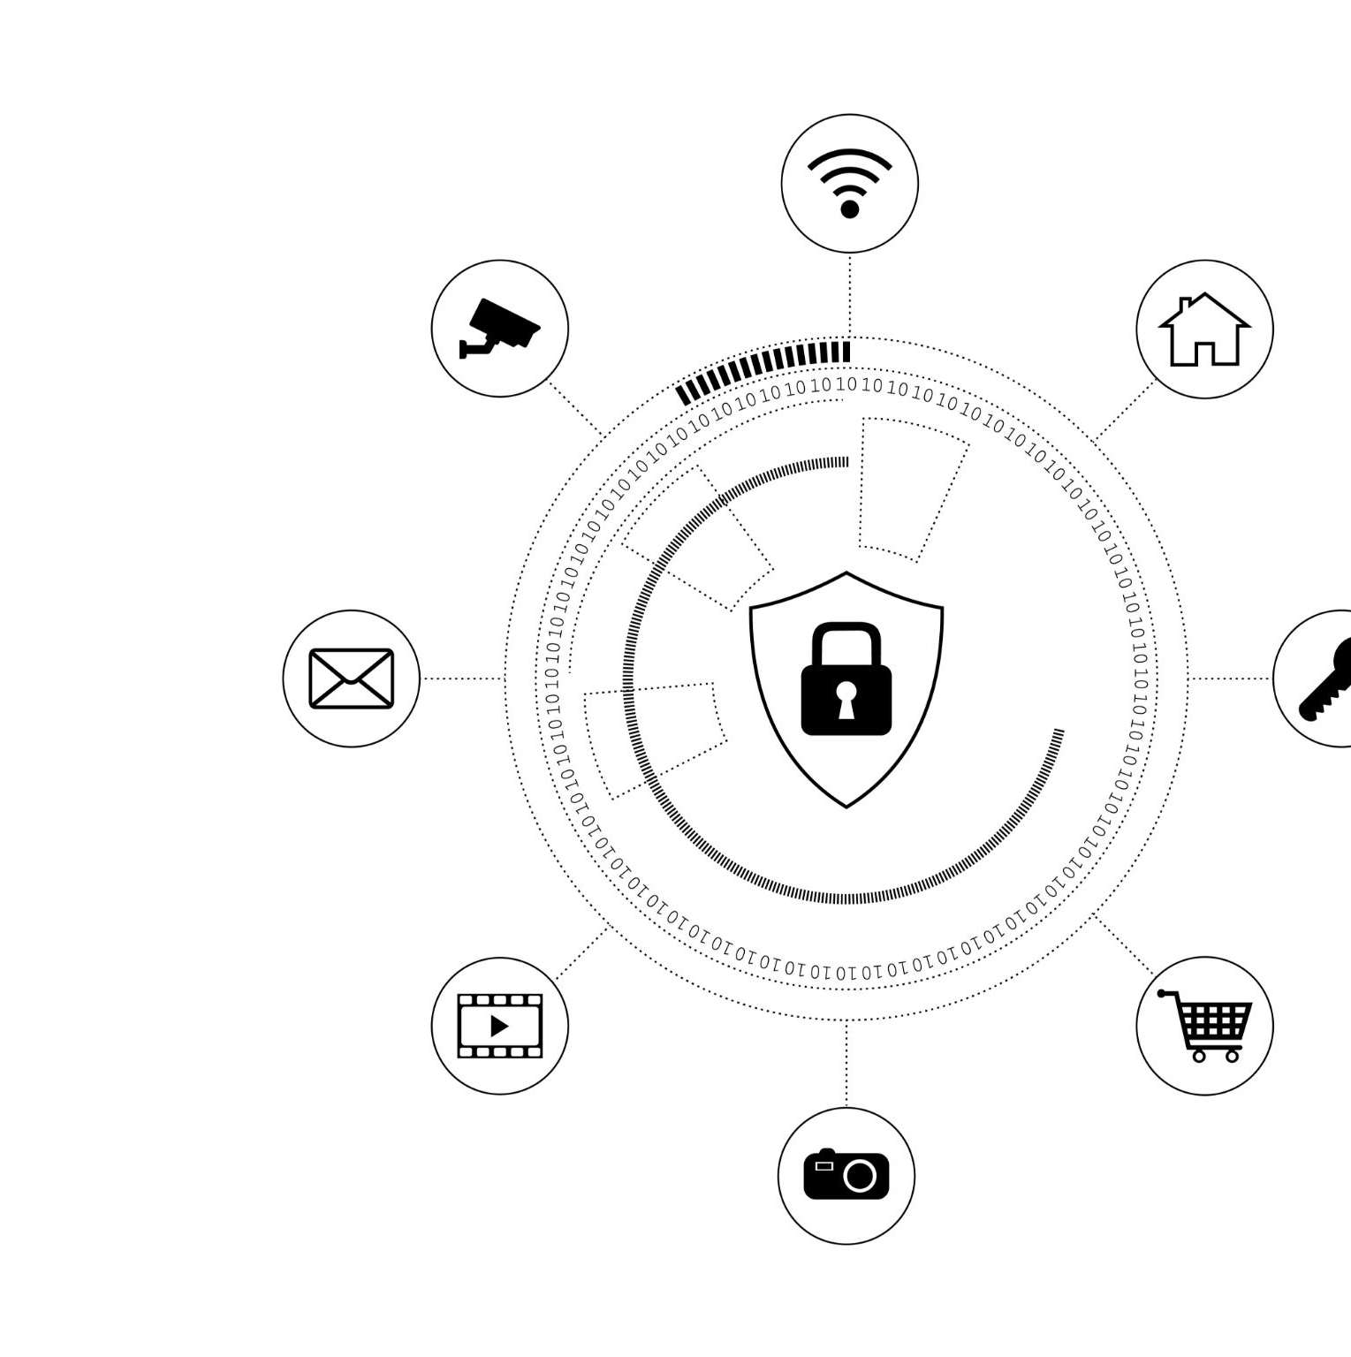
Core Services and Responsibilities
User and Identity Management
Handles user profiles, roles, and authentication integrating with secure token issuance systems.
Audit and Compliance Tracking
Records system and user actions to ensure compliance and provide detailed traceability.
Property and Lease Management
Manages property data and rental agreements, maintaining tenant-property relationships efficiently.
Notification Services
Sends automated alerts for rent reminders and lease expirations triggered by system events.
Notes:
--- This slide references information from the following file: https://apiitlk-my.sharepoint.com/personal/ama_apiit_lk/Documents/Microsoft%20Copilot%20Chat%20Files/Microservices%20List.md The system comprises five core microservices: User/Identity Service, Audit & Compliance Service, Property Registration Service, Lease & Tenancy Management Service, and Notification Service. The User/Identity Service manages user profiles and roles, integrating with WSO2 Asgardio for authentication and token issuance. The Audit Service records system and user actions for compliance, ensuring traceability. The Property Service handles CRUD operations for properties, while the Lease Service manages rental agreements and tenant-property relationships. The Notification Service sends alerts for rent reminders and lease expirations, triggered by events from the Lease Service. These services are developed using .NET for identity and audit, Spring Boot for property, lease, and notification logic, and React for the frontend SPA. This division leverages technology strengths for security, performance, and business logic implementation.

Slide 8
Database Design
Notes:
--- This slide references information from the following file: https://apiitlk-my.sharepoint.com/personal/ama_apiit_lk/Documents/Microsoft%20Copilot%20Chat%20Files/CICD+GitOps+Security-Flow.md Entity Relationship Model

Slide 9
Entity Relationship Model
Core Database Entities
The model includes USERS, PROPERTIES, LEASES, AUDIT_LOGS, and SENT_NOTIFICATIONS as primary entities for data organization.
Entity Relationships
Foreign key constraints maintain referential integrity by linking leases to users and properties, ensuring consistent data.
Scalability and Modularity
Distributed schema across services supports modular development and scalability while preserving data consistency and integrity.
Notes:
--- This slide references information from the following file: https://apiitlk-my.sharepoint.com/personal/ama_apiit_lk/Documents/Microsoft%20Copilot%20Chat%20Files/CICD+GitOps+Security-Flow.md The database design follows a normalized schema distributed across multiple services. Key entities include USERS, PROPERTIES, LEASES, AUDIT_LOGS, and SENT_NOTIFICATIONS. USERS table stores identity details linked to external Asgardio IDs, while PROPERTIES maintains property attributes such as name, address, and type. LEASES connects tenants to properties and tracks lease duration, rent amount, and status. AUDIT_LOGS records actions performed by users and services for compliance purposes, and SENT_NOTIFICATIONS logs messages sent to users. Foreign key relationships ensure referential integrity, such as linking leases to properties and users. This design supports scalability and modularity, enabling independent service evolution while maintaining data consistency.

Slide 10
Deployment & Infrastructure
Notes:
--- This slide references information from the following file: https://apiitlk-my.sharepoint.com/personal/ama_apiit_lk/Documents/Microsoft%20Copilot%20Chat%20Files/AWS_Istio_Microservice_Architecture.md Kubernetes and Service Mesh Integration

Slide 11

Kubernetes and Service Mesh Integration
Container Orchestration with Kubernetes
Kubernetes manages containerized microservices as pods, providing scalability and high availability within the cluster.
Istio Service Mesh Security
Istio sidecar proxies enable secure inter-service communication using mTLS and enforce zero trust policies via AuthorizationPolicy.
Infrastructure Components
The infrastructure includes EC2 instances as cluster nodes and a dedicated MySQL instance for persistent data storage.
GitOps Deployment Automation
ArgoCD implements GitOps by monitoring Git repositories and synchronizing manifests to minimize manual deployment effort.
Notes:
--- This slide references information from the following file: https://apiitlk-my.sharepoint.com/personal/ama_apiit_lk/Documents/Microsoft%20Copilot%20Chat%20Files/AWS_Istio_Microservice_Architecture.md The deployment strategy leverages Kubernetes for container orchestration, ensuring high availability and scalability. Microservices are deployed as pods within the cluster, each integrated with Istio sidecar proxies for service mesh capabilities. Istio enforces mTLS for secure inter-service communication and applies zero trust policies through AuthorizationPolicy configurations. The infrastructure includes EC2 instances for cluster nodes and a dedicated MySQL instance for persistent storage. GitOps principles are implemented using ArgoCD, which continuously monitors Git repositories for manifest changes and synchronizes them with the cluster. This approach minimizes manual intervention, reduces configuration drift, and accelerates deployment cycles.

Slide 12
Tools & Technologies
Notes:
--- This slide references information from the following file: https://apiitlk-my.sharepoint.com/personal/ama_apiit_lk/Documents/Microsoft%20Copilot%20Chat%20Files/AWS_Istio_Microservice_Architecture.md Technology Stack and Justification

Slide 13

Technology Stack and Justification
Version Control and Automation
GitHub and GitHub Actions enable efficient version control and streamline CI/CD automation processes.
Containerization and Orchestration
Docker and Kubernetes provide containerization and orchestration for scalable and portable deployments.
Infrastructure as Code
Terraform and Ansible automate consistent provisioning of infrastructure through code-driven workflows.
Monitoring and Security
Prometheus, Grafana, OpenSearch monitor systems while Trivy and Snyk ensure security via vulnerability scanning.
Notes:
--- This slide references information from the following file: https://apiitlk-my.sharepoint.com/personal/ama_apiit_lk/Documents/Microsoft%20Copilot%20Chat%20Files/AWS_Istio_Microservice_Architecture.md The project employs a diverse technology stack to address various functional and operational requirements. GitHub and GitHub Actions facilitate version control and CI/CD automation. Docker and Kubernetes provide containerization and orchestration, ensuring portability and scalability. Terraform and Ansible enable Infrastructure as Code (IaC) for consistent environment provisioning. Monitoring and observability are achieved through Prometheus, Grafana, and OpenSearch. Security tools like Trivy and Snyk perform image scanning and vulnerability assessments. WSO2 Asgardio handles identity management and authentication, while Istio enforces zero trust principles within the service mesh. This combination of tools ensures a robust, secure, and efficient development and deployment pipeline.

Slide 14
CI/CD and GitOps Workflow
Notes:
--- This slide references information from the following file: https://apiitlk-my.sharepoint.com/personal/ama_apiit_lk/Documents/Microsoft%20Copilot%20Chat%20Files/CICD+GitOps+Security-Flow.md Pipeline Flow and Security Integration

Slide 15
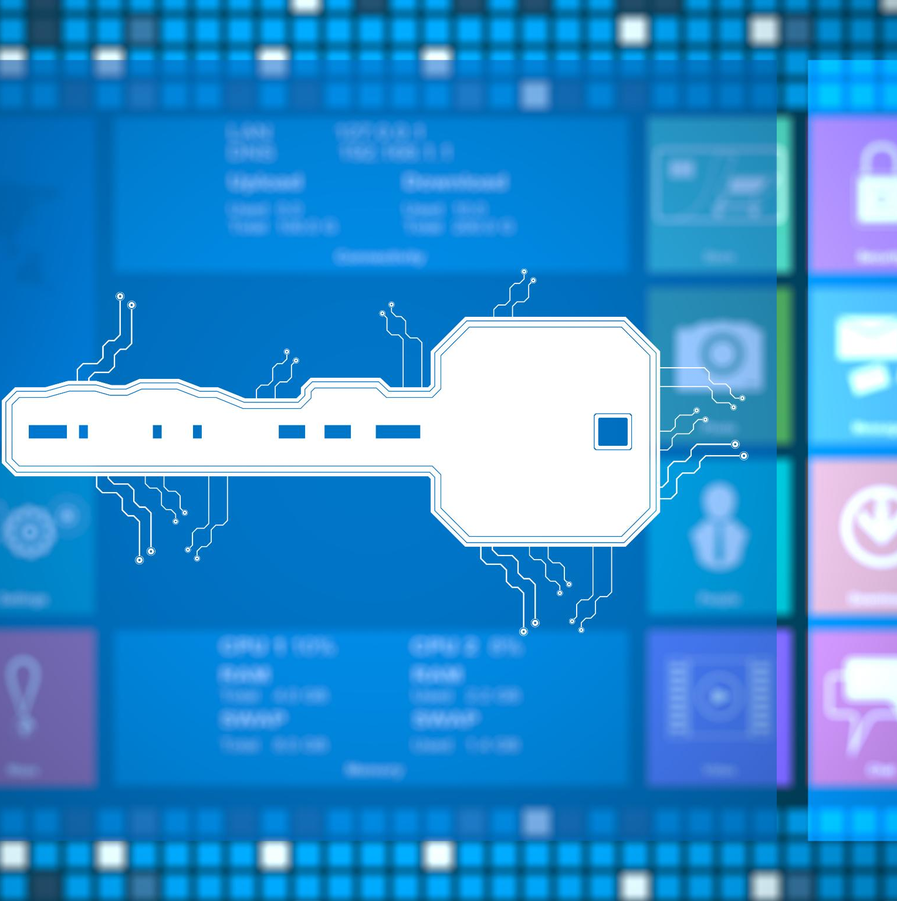
Pipeline Flow and Security Integration
CI/CD Pipeline Workflow
Developers push code triggering workflows that build Docker images and run unit tests automatically.
Security Scanning and Image Distribution
Security scans using Trivy validate images before pushing them to Docker Hub or AWS ECR registries.
GitOps Deployment and Synchronization
ArgoCD monitors manifest updates in Git repository and synchronizes Kubernetes clusters accordingly.
Istio Sidecars and Security Policies
Istio sidecars are injected to enforce mTLS and zero trust policies during application deployment.
Notes:
--- This slide references information from the following file: https://apiitlk-my.sharepoint.com/personal/ama_apiit_lk/Documents/Microsoft%20Copilot%20Chat%20Files/CICD+GitOps+Security-Flow.md The CI/CD pipeline begins with developers pushing code changes to GitHub repositories, triggering GitHub Actions workflows. The pipeline includes stages for building Docker images, running unit tests, and performing security scans using Trivy. Once validated, images are pushed to Docker Hub or AWS ECR. GitOps principles are applied by updating deployment manifests in a dedicated repository, which ArgoCD monitors for changes. Upon detecting updates, ArgoCD synchronizes the Kubernetes cluster with the latest configurations. Istio sidecars are injected during deployment to enforce mTLS and zero trust policies. This workflow ensures continuous delivery, security compliance, and operational consistency across environments.

Slide 16
Security and Zero Trust Implementation
Notes:
--- This slide references information from the following file: https://apiitlk-my.sharepoint.com/personal/ama_apiit_lk/Documents/Microsoft%20Copilot%20Chat%20Files/AWS_Istio_Microservice_Architecture.md,https://apiitlk-my.sharepoint.com/personal/ama_apiit_lk/Documents/Microsoft%20Copilot%20Chat%20Files/CICD+GitOps+Security-Flow.md Security Measures and Best Practices

Slide 17

Security Measures and Best Practices
Zero Trust and Encryption
Istio's mTLS enforces encrypted service-to-service communication following zero trust security principles.
Secrets and Vulnerability Management
Secrets management secures sensitive data while tools like Trivy and Snyk scan container images for vulnerabilities.
Application Security Testing
SAST and DAST are integrated into CI/CD pipelines to detect code-level security risks early in development.
Access Control and Traffic Security
RBAC controls Kubernetes permissions, and TLS termination at gateways secures external traffic effectively.
Notes:
--- This slide references information from the following file: https://apiitlk-my.sharepoint.com/personal/ama_apiit_lk/Documents/Microsoft%20Copilot%20Chat%20Files/AWS_Istio_Microservice_Architecture.md,https://apiitlk-my.sharepoint.com/personal/ama_apiit_lk/Documents/Microsoft%20Copilot%20Chat%20Files/CICD+GitOps+Security-Flow.md Security is a cornerstone of the system, implemented through multiple layers. Zero trust principles are enforced using Istio's mTLS for encrypted service-to-service communication and AuthorizationPolicy for fine-grained access control. Secrets management ensures sensitive data is securely stored and accessed. Image scanning tools like Trivy and Snyk detect vulnerabilities in container images before deployment. Static and dynamic application security testing (SAST/DAST) are integrated into the CI/CD pipeline to identify code-level risks. Role-based access control (RBAC) governs permissions within Kubernetes, while TLS termination at the gateway secures external traffic. These measures collectively create a resilient security posture for the platform.

Slide 18
Monitoring and Logging
Notes:
--- This slide references information from the following file: https://apiitlk-my.sharepoint.com/personal/ama_apiit_lk/Documents/Microsoft%20Copilot%20Chat%20Files/AWS_Istio_Microservice_Architecture.md Observability Stack and Alerting

Slide 19

Observability Stack and Alerting
Metrics Collection and Visualization
Prometheus collects metrics while Grafana visualizes real-time system performance and health data.
Log Aggregation and Analysis
Fluentd gathers logs from microservices and sends them to OpenSearch for indexing and in-depth analysis.
Insightful Dashboards
Grafana and OpenSearch dashboards provide detailed views of application behavior and resource utilization.
Proactive Alerting
Alerting systems notify operators about anomalies to ensure timely issue detection and resolution.
Notes:
--- This slide references information from the following file: https://apiitlk-my.sharepoint.com/personal/ama_apiit_lk/Documents/Microsoft%20Copilot%20Chat%20Files/AWS_Istio_Microservice_Architecture.md The observability framework integrates Prometheus for metrics collection and Grafana for visualization, enabling real-time performance monitoring. Fluentd aggregates logs from microservices and forwards them to OpenSearch for indexing and analysis. Dashboards in Grafana and OpenSearch provide insights into system health, resource utilization, and application behavior. Alerting mechanisms are configured to notify operators of anomalies, ensuring proactive issue resolution. This comprehensive monitoring and logging setup enhances reliability, facilitates troubleshooting, and supports capacity planning.

Slide 20
Challenges and Solutions
Notes:
Implementation Hurdles and Resolutions

Slide 21

Implementation Hurdles and Resolutions
Zero Trust Configuration
Implementing Istio for zero trust enforcement posed configuration challenges resolved through iterative testing and best practices.
CI/CD Workflow Management
Complex CI/CD workflows were managed using GitOps automation, streamlining deployments and reducing manual tasks.
Performance Optimization
Database performance bottlenecks were resolved by optimizing schema design and implementing indexing strategies.
Security Enhancements
Advanced scanning tools and strict RBAC policies mitigated security concerns and strengthened architecture.
Notes:
During implementation, several challenges were encountered, including configuring Istio for zero trust enforcement, managing complex CI/CD workflows, and ensuring seamless integration between microservices. These issues were addressed through iterative testing, leveraging community best practices, and automating repetitive tasks using GitOps. Performance bottlenecks in database queries were resolved by optimizing schema design and indexing strategies. Security concerns were mitigated by incorporating advanced scanning tools and enforcing strict RBAC policies. These solutions not only resolved immediate issues but also strengthened the overall architecture.

Slide 22
Results and Future Improvements
Notes:
Achievements and Roadmap

Slide 23
Achievements and Roadmap
Project Achievements
Delivered a modular, secure, and scalable real estate platform with automated GitOps deployments and zero trust security.
Performance Improvements
Enhanced system reliability and response times through comprehensive observability and performance benchmarking.
Future Enhancements
Plan to improve user experience with AI-driven recommendations, advanced analytics, multi-cloud support, and stronger security.
Notes:
The project successfully delivered a modular, secure, and scalable real estate management platform. Key achievements include automated deployments via GitOps, robust security through zero trust principles, and comprehensive observability. Performance benchmarks indicate improved response times and system reliability. Future improvements will focus on enhancing user experience through advanced analytics, integrating AI-driven property recommendations, and expanding multi-cloud support. Additional security enhancements, such as continuous compliance checks and advanced threat detection, are also planned to maintain a strong security posture.

Slide 24
DEMO
Notes:
Achievements and Roadmap

